Slide 1
COSMONAUTS
Made by students of 9 B form

Slide 2
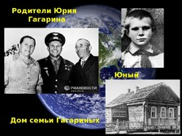
Yuri Alekseevich Gagarin was born on March 9, 1934, in the village of Klushino (now Gagarinsky district of the Smolensk region). By origin, he comes from peasants: his father is a carpenter, his mother worked on a farm. In 1941, the war interrupted his studies at school. After the war, the Gagarin family moved to the city of Gzhatsk, where Yuri, after graduating from a craft school and evening school, enters the Saratov Industrial College and enlists in a flight club. In 1955, he was drafted into the army, where he was sent to an aviation school.

Slide 3
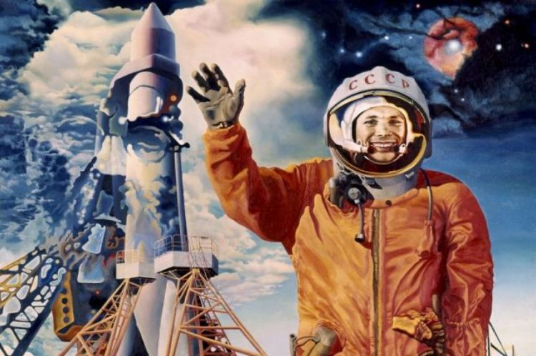
On December 9, 1959, Gagarin was enrolled in a group of candidates for astronauts, where regular classes began. On April 12, 1961, the Vostok rocket was launched from the launch pad of the Baikоnur under the control of Yuri Gagarin. He made the first space flight in human history. For this feat, he was awarded the title Hero of the Soviet Union. Day - April 12 - declared a holiday - Cosmonautics Day.

Slide 4
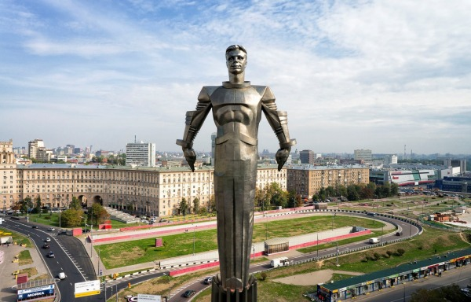
March 27, 1968 Gagarin died during one of the training flights.
The phrase - he said "Let's go!" - has become a kind of symbol of the new, cosmic era of mankind. In honor of the world's first astronaut, countless Russian streets and schools are named. In his honor, his hometown of Gzhatsk was renamed Gagarin. The monument to Yuri Alekseevich Gagarin is located in Moscow on Leninsky Prospekt.

Slide 5
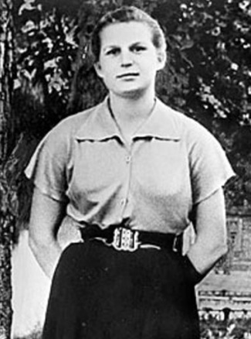
Valentina Tereshkova
At the age of 22 she made her first parachute jump in the local aviation club. She was keen on skydiving and she was noticed by the people from the Soviet space program, who wanted to put a woman in space in the early 1960s. Tereshkova was skilled enough for that. In February 1962 she began intensive training to become a cosmonaut.

Slide 6
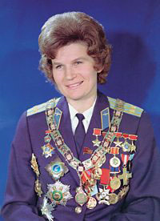
In 1963 Tereshkova was selected to the second flight in the Vostok program and on the 16th of June Vostok 6 was launched into space. Tereshkova didn’t guide the spacecraft, it was guided by an automatic control system. On June 19 Tereshkova successfully parachuted to the earth.

Slide 9
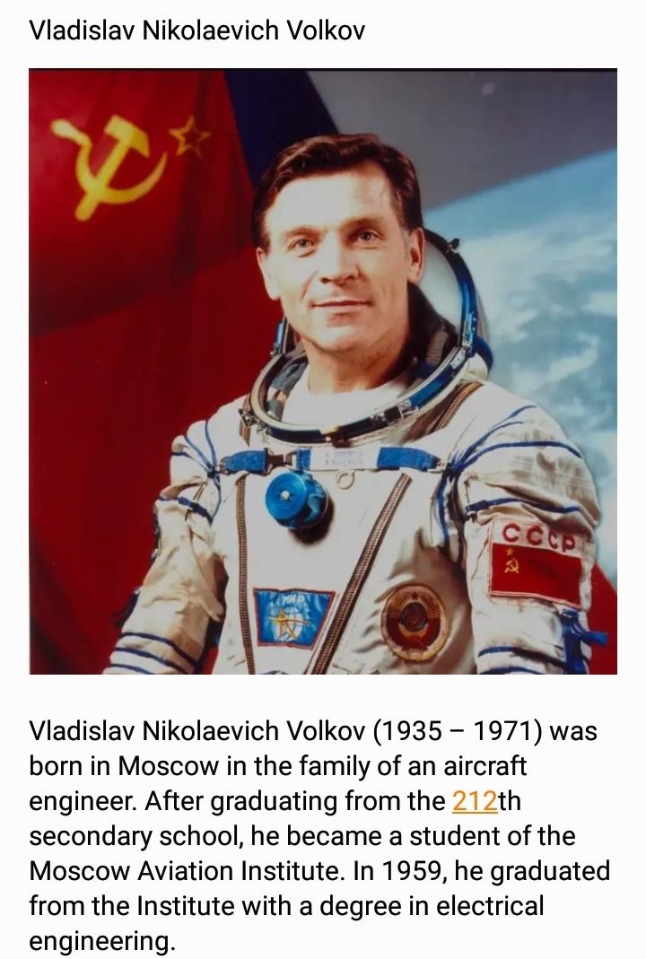

Slide 11
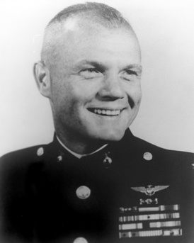
John Herschel Glenn (1921-2016)

Slide 12
Biography:
John Herschel Glenn Jr. (Columbus, Ohio, USA) is an American NASA astronaut, inventor, entrepreneur, and political activist. The third person in the world after Yuri Gagarin and Herman Titova and the first US astronaut in space to make an orbital space flight (Mercury-Atlas-6, February 1962), test pilot, Marine Corps pilot in World War II and the Korean War, Senator (D) from Ohio.
After the end of World War II, he continued to serve as a pilot on the island of Guam. He participated in the Korean War, serving in the theater of operations for two terms: the first - as part of a Marine Corps squadron on the F9F "Panther", the second-as part of the US Air Force replacement program on the F-86 "Sabre".

Slide 13
Achievements:
On February 20, 1962, on the Mercury-Atlas 6 spacecraft, Colonel John Glenn, 41 years old, made 3 orbits around the globe in 4h 55m, becoming Man No5 in space.
By the time of his high flight, Glenn was already a very well-deserved pilot. As a combat American, he flew 59 combat missions over the Marshall Islands. Then he participated in the Korean War. First I flew the F9F "Panther". Then he retrained on the F-86 Sabre. It was on the Sabres that Glenn proved his high flying skills by shooting down 3 Soviet MiG-15s in 2 weeks.

Slide 14
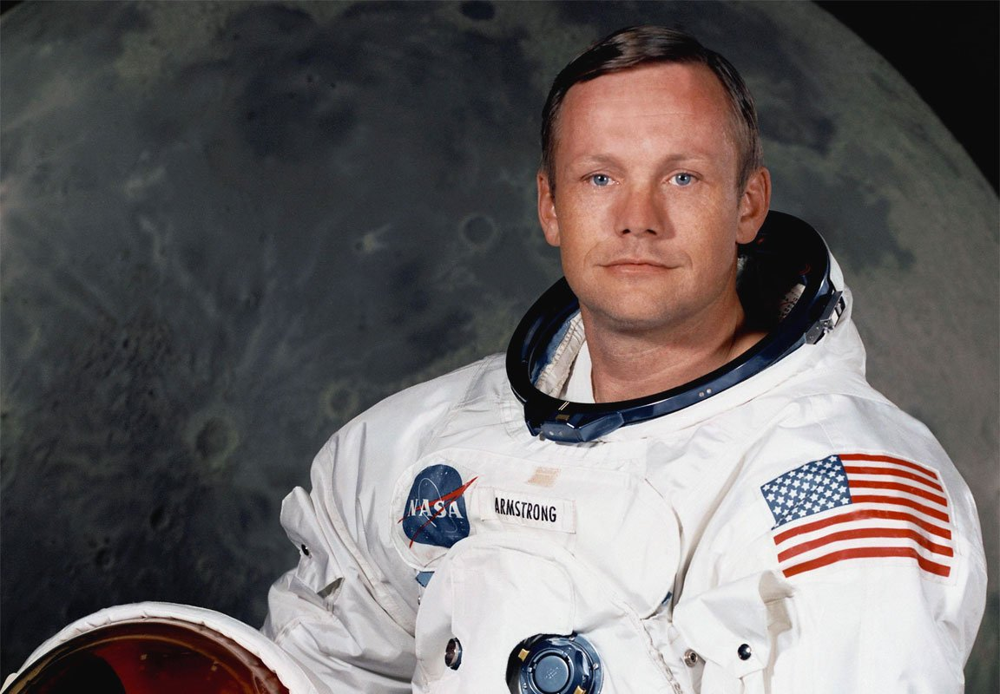
Neil Armstrong

Slide 15
Childhood
Neil Armstrong was born on 5th Аugust, 1930, in Wapakoneta, Ohio State, USA
Stephen Armstrong (father) worked as an auditor for the Ohio state government;
The family moved around the state
many times after Armstrong's
birth, living in 20 towns

Slide 16
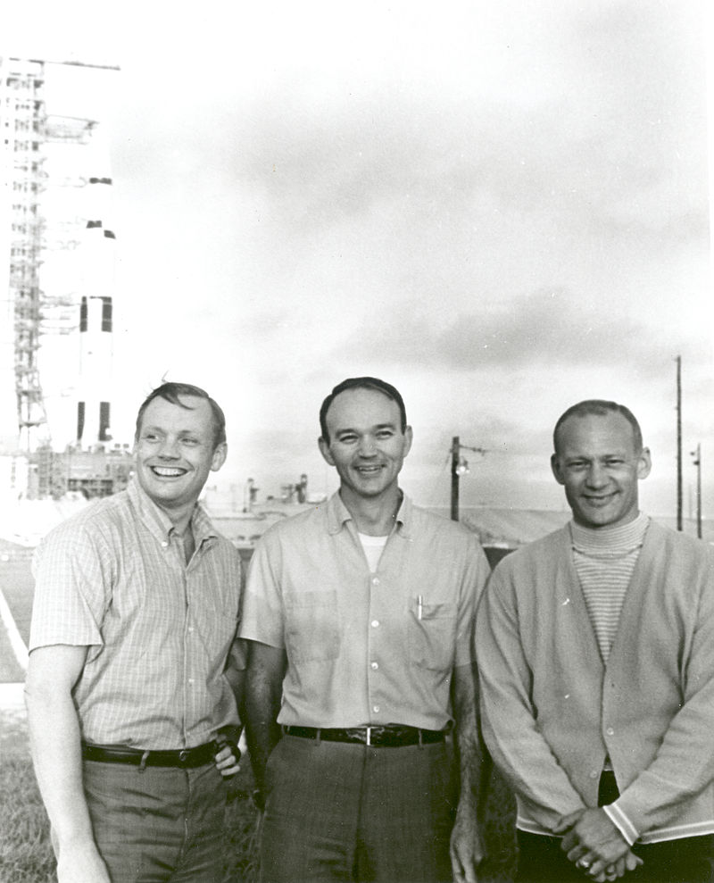
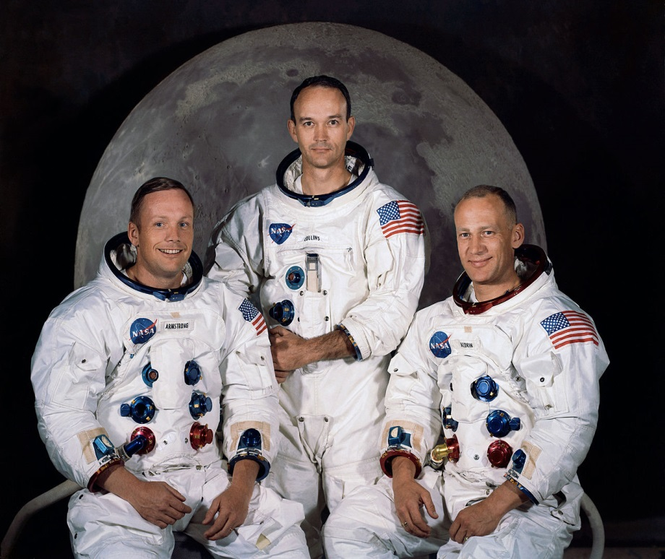
Flying to the Moon
Armstrong flew to the Moon on spaceship «Apollo 11». It was launched 16th of July of 1969 from space center Kennedy in Florida
Some years ago…

Slide 17
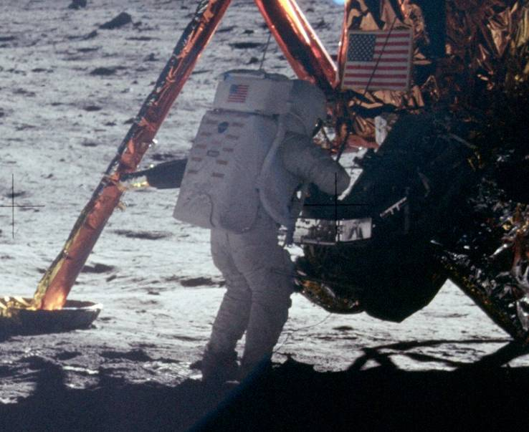
Moon walk
20 July Apollo 11 sat to the Moon.
He told, that Moon ground was gray, brown and plain; there were many craters and little of hills.

